Slide 1
Processor Verification
Muhammad Bilal Sakhawat
Nov, 10 2021

Slide 2
Table of Contents
Processor
RISC-V Single Cycle Processor
Verification and Types
Coverage driven Verification
Coverage Metrics
Example
Verification Techniques
Open Source Contributions
What is ISA Compliance?
RISC-V Compliance and Challenges
RISCOF
Components of RISCOF
RISCOF Flow Diagram

Slide 3
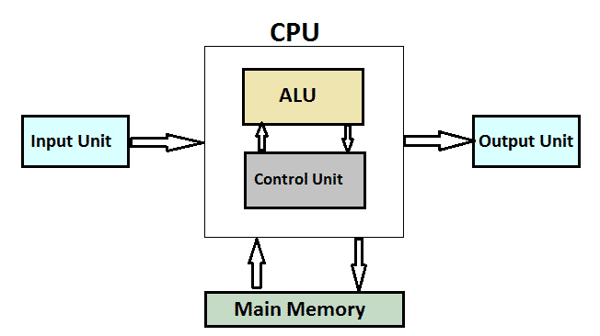
Processor
A Processor in an integrated electronic circuit that performs the calculations that run a computer. A processor performs arithmetical, logical, input/output (I/O) and other basic instructions that are passed from an operating system.

Slide 4
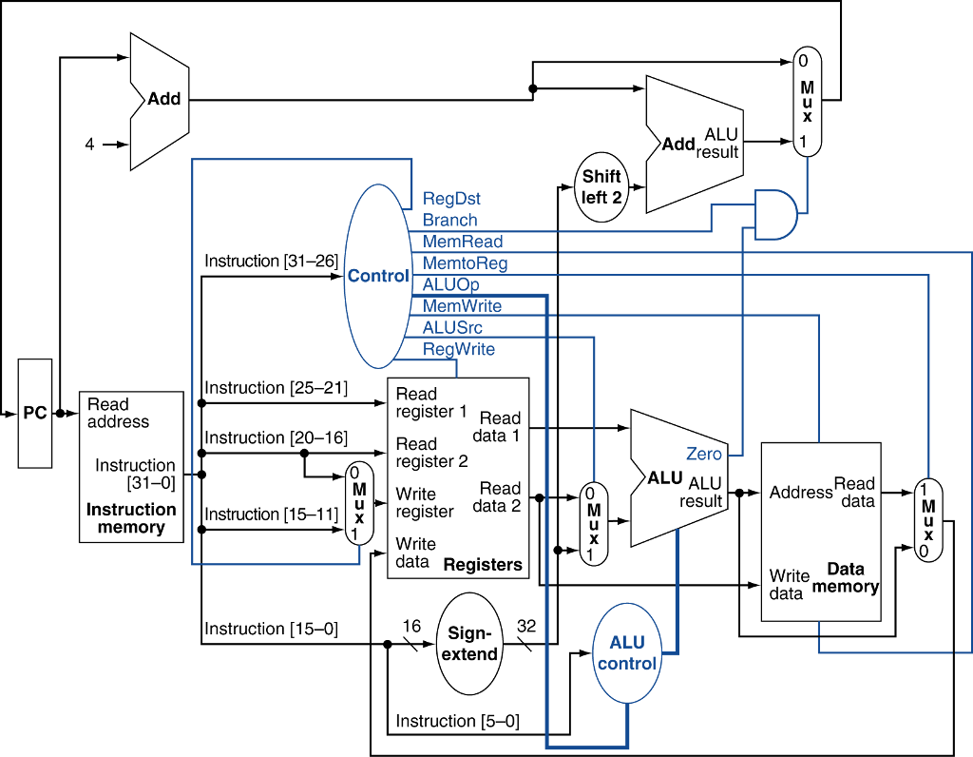
RISC-V Single Cycle Processor

Slide 5
Verification and Types
Design Verification in the process to demonstrate the correctness of the design as per the specification documents.
Types of Verification:
Functional Verification
Timing Verification
Formal Verification
Performance Verification

Slide 6
Coverage Driven Verification
In Coverage driven verification, we define cover points that check the functionality of processor on structural level and functionality as a whole. We make sure each and every line of code is executed. And that each signal is toggled and every branch is exercised.
Coverage Types:
Structural Coverage (FSM, Queue)
Code Coverage (line, toggle and branch coverage)
Functional Coverage (Functionality of each module)

Slide 7
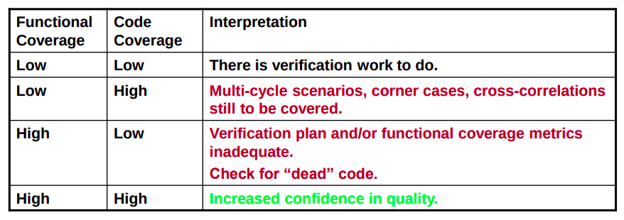
Coverage Metrics

Slide 8
Example Exercise
Verilator is a free software used for the simulation and verification Hardware Implementations. It “Verilates” the specified Verilog or SystemVerilog code by reading it, performing lint checks, and optionally inserting assertion checks and coverage-analysis points.
Verilator Installation: https://verilator.org/guide/latest/install.html
Verilator Manual: https://www.veripool.org/ftp/verilator_doc.pdf
Open Source Example: https://github.com/n-kremeris/verilator_basics
Coverage: https://verilator.org/guide/latest/exe_verilator_coverage.html

Slide 9
Verification Techniques
Self Check Tests
Write self checking C or assembly Tests
Signature Comparison
Run same program on reference and DUT, Store the results in memory which makes a signature for comparison
Trace log Comparison
Run same program on reference and DUT, disassembly, user-register, system-register and Operating Mode
Step and Compare
Run same program instruction by instruction on both reference and DUT, and compare the results at each step

Slide 10
Open Source Contributions
The word open source refers to any program whose source code is made available for use or modification as users or other developers see fit. Unlike proprietary software, open source software is developed as a public, open collaboration and made freely available to public.
Open source contributions can play a very important role in the growth of both organizations and individuals who contribute. You can take ideas, suggestions and help from experts outside of your organization. You can keep yourself updated with the new technology.
Link: RISC-V Development Partner Status

Slide 11
What is ISA Compliance?
ISA compliance means that an implementation of the ISA adheres the ISA specifications.
Compliance checks:
Available registers, their widths, access combinations, correct sign extension, etc.
Available instructions and basic sanity checks (e.g. ADD performs an addition not a subtraction)
No additional behavior accidentally added
Compliance ensures: Compatibility with RISC-V SW ecosystem

Slide 12
RISC-V Compliance and Challenges
“RISC-V is an open-source standard ISA with exceptional modularity and extensibility. Anyone can build an implementation and there are no license fees [...]. Implementers are free to add custom extensions to boost capabilities and performance, while at the same time don’t have to include features that aren’t needed.” Allen Baum, chair of the RISC-V Compliance Task Group
source: https://semiengineering.com/toward-risc-v-compliance, by Brian Bailey, 2019
An increasingly large number of customized RISC-V cores is being implemented
Unconstrained flexibility greatly increases risk of introducing incompatibilities
Compliance Testing becomes very important and challenging

Slide 13
Components of RISCOF
The RISCOF (RISC-V Compliance Framework ) consists of following components:
RISCV-CONFIG: Need a standard format to express what choices of the ISA have been implemented by the DUT.
API Plugins for Model: RISC-V implementation can range from ISS, formal models, soft cores, asic, RTLs, etc. A common plugin API to integrate these into RISCOF seamlessly.
CGF: Need a mechanism to quantify the quality of tests being used. This should be scalable to account for future extensions as well.
RISCV-ISAC: Need a tool to extract coverage of the tests executed on the golden models.
RISCV-CTG: Is it possible to automate the generation of tests to meet maximum coverage with minimal set of instructions?

Slide 14
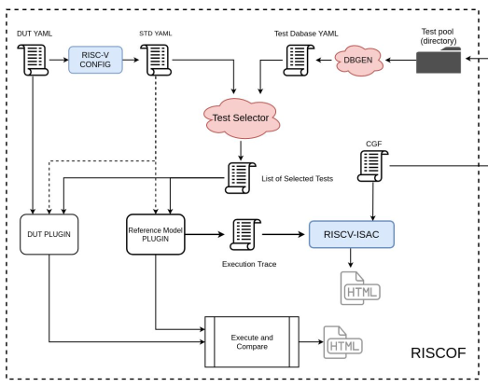
RISCOF Flow Diagram
RISCV-CTG

